Slide 1
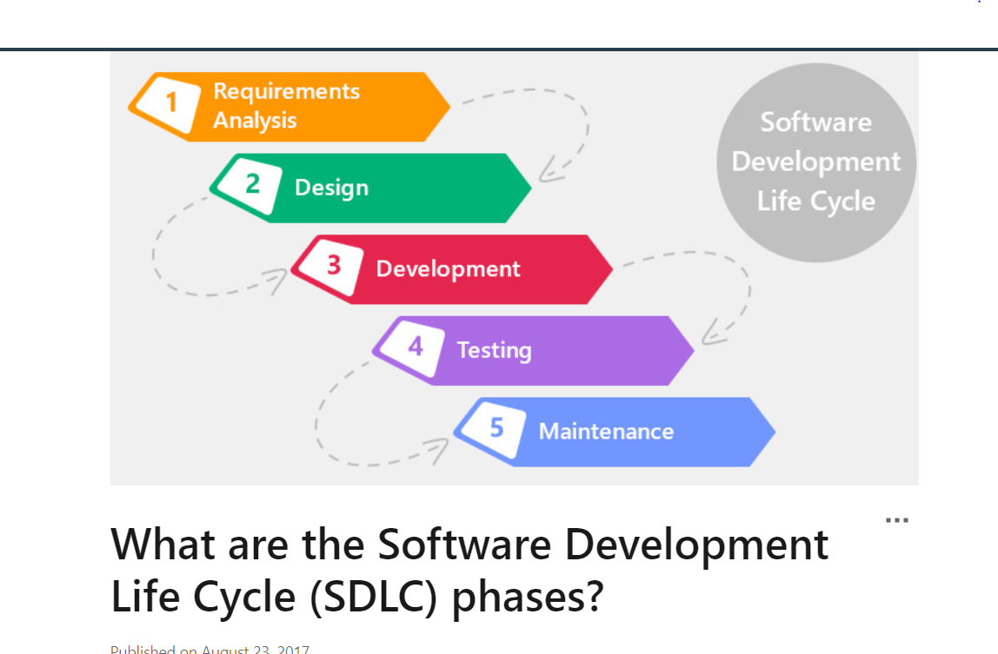
Software Development Life Cycle (SDLC)

Slide 2
Software Process Framework
Framework is a Standard way to build and deploy applications.
Software Process Framework is the foundation of complete software engineering process.
Software process framework includes set of all umbrella activities.
It also includes number of framework activities that are applicable to all software projects.

Slide 3
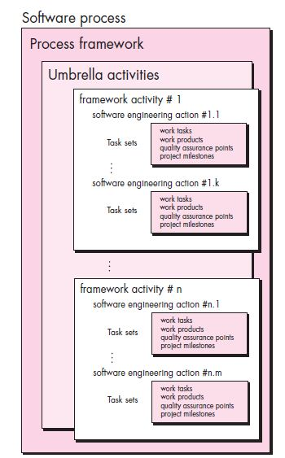
Process Framework

Slide 4
Umbrella Activities
Software project tracking and control
Risk Management
Software Quality Assurance
Technical review
Measurement
Software configuration management
Reusability management
Work product preparation and production

Slide 5
Generic Process Model
Communication
Planning
Modeling
Construction
Deployment

Slide 6
Process Model
Communication:
Before any technical work commence, it is important to communicate and collaborate with the customer and other stake holder.
The intent is to understand stakeholders’ objective for the project and to gather requirements that help define software and functions.

Slide 7
Process Model
Planning
Planning helps to define the software project plan
Software Engineering plan defines the software engineering work by describing the technical tasks to be conducted, the risks that are likely, the resources that will be required, the work product to be produced, and a work schedule

Slide 8
Software Process Model
Modeling
By creating the models helps to better understand the software requirement and the design that will achieve those requirement.

Slide 9
Software Process Model
Construction
This activity combines code generation and the testing that is required to uncover errors in the code.

Slide 10
Software Process Model
Deployment
The software is delivered to the customer who evaluates the delivered product and provides feedback based on the evaluation.

Slide 11
Software Process
Software Process
Software process is the framework for the activities, action, and tasks that are required to build high quality software.

Slide 12

Process Flow
A linear process flow executes each of the five framework activities in sequence, beginning with communication and culminating with deployment.

Slide 13
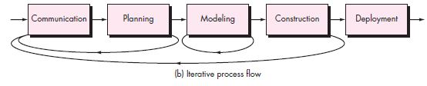
Process Flow
An iterative process flow repeats one or more of the activities before proceeding to the next.

Slide 14
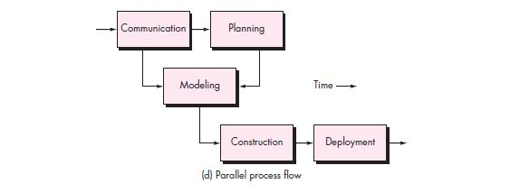
Process Flow
A parallel process flow executes one or more activities in parallel with other activities.

Slide 15
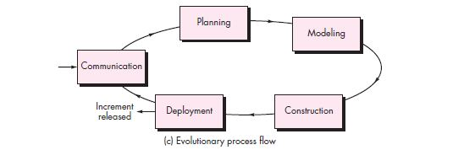
Process Flow
An evolutionary process flow executes the activities in a “circular” manner.

Slide 16
Process Flow

Slide 17
Process Model of Software Engineering
Waterfall model
Incremental model
Prototype model
Spiral model
RAD model
Agile (Framework->Scrum)

Slide 18
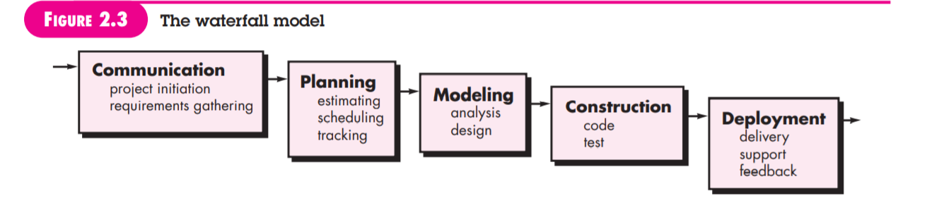
Software Process model
Waterfall model
Requirement are well understood

Slide 19
Waterfall Model
The waterfall model is the oldest paradigm for software engineering
When to use Waterfall model?
Requirement are very well known
Production definition is stable
Technology is understood
New version of existing product

Slide 20
Advantages of waterfall model
This model is simple and easy to understand and use.
It is easy to manage due to the rigidity of the model – each phase has specific deliverables and a review process.

Slide 21
Disadvantage
Once an application is in the testing stage, it is very difficult to go back and change something that was not well-thought out in the concept stage.
Not suitable for the projects where requirements are at a moderate to high risk of changing.

Slide 22
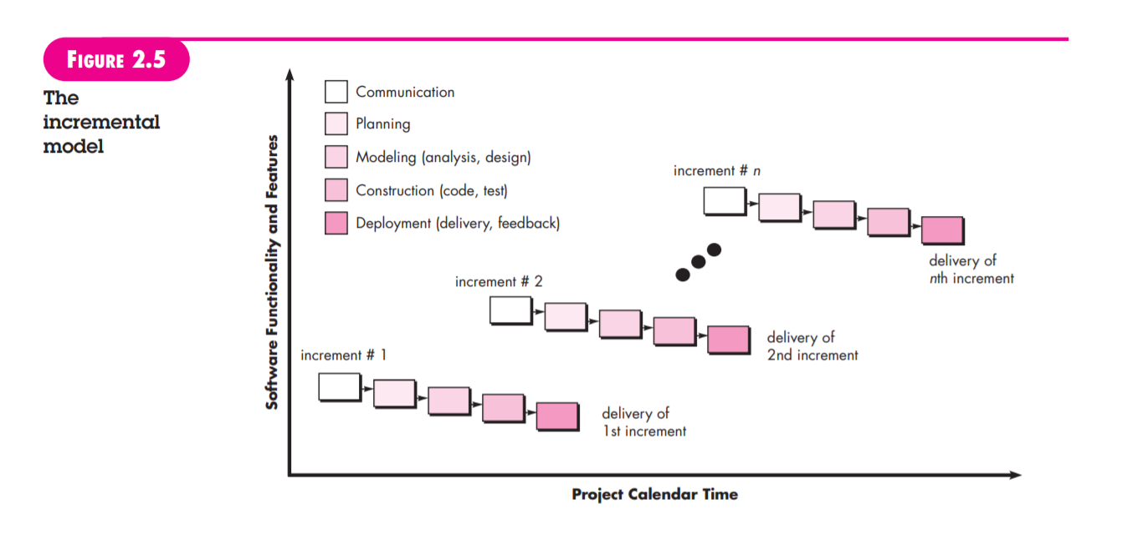
Software process model
Incremental model
When an incremental model is used, the first increment is often a core product
IF there may be a compelling need to provide a limited set of software functionality to users quickly and then refine and expand on that functionality in later software releases.

Slide 23
Incremental Model
Incremental model delivers a series of releases, called increments, that provide progressively more functionality for customer as each increment delivered.
The first increment is often a core product.
Basic requirement are addressed but many supplementary features remain undelivered

Slide 24
Incremental Model
When to use?
Useful when staffing unavailable for a complete implementation of project till deadline.
If the core product is well received, then additional staff (if required) can be added to implement the next increment.
When software engineering team are not very well skilled or trainee

Slide 25
Evolutionary Model
Evolutionary process model produce an increasingly more complete version of the software with each iteration.

Slide 26
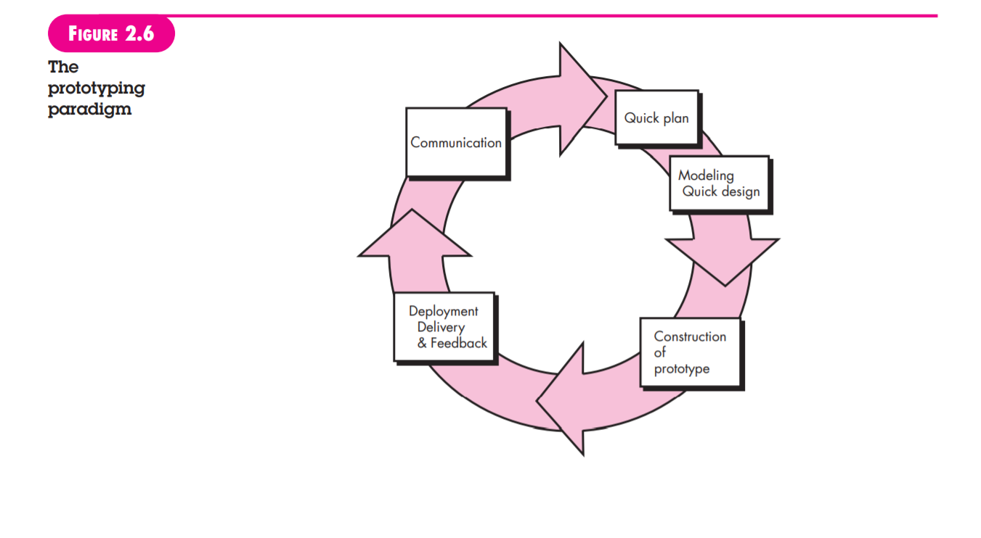
Software Process model
Prototype model
Often, a customer defines a set of general objectives for software, but does not identify detailed requirements for functions and features. In other cases, the developer may be unsure of the efficiency of an algorithm

Slide 27
Prototyping
When to use?
Customer defines a set of general objectives for software, but does not identify detailed requirements for functions and features
Developer may be unsure of the efficiency of an algorithm, the adaptability of an operating system

Slide 28
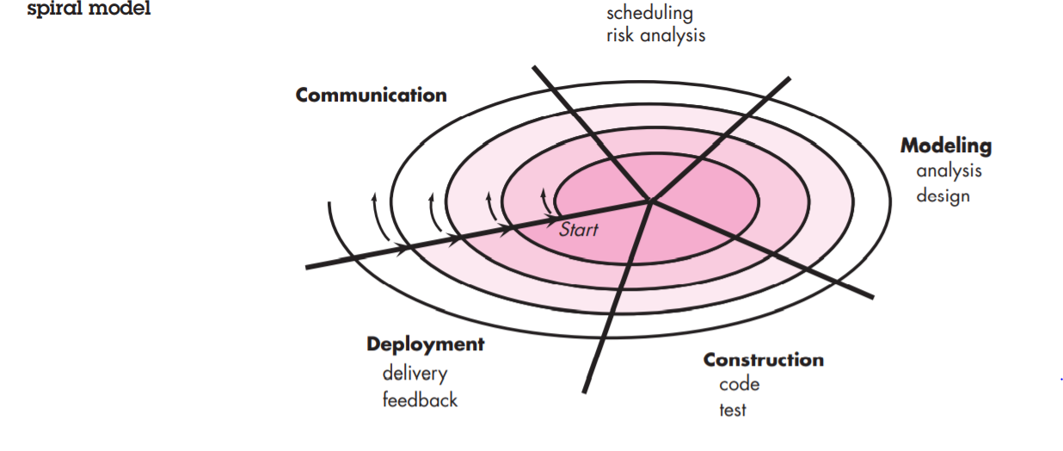
Software Process Model
Spiral Model
The spiral development model is a risk-driven process model generator that is used to guide multi-stakeholder concurrent engineering of software intensive systems

Slide 29
Spiral Model
The spiral model is a risk-driven process model.
Software is developed in series of evolutionary releases
During early iteration, release might be a model or prototype.
Later iterations, increasingly complete versions of the product
The spiral model is the realistic approach to the development of large scale systems and software

Slide 30
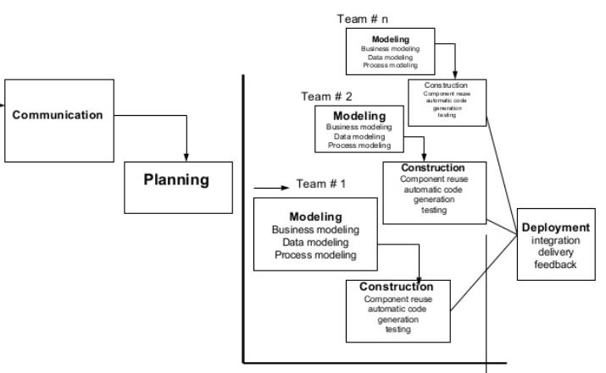
Software process model
Rapid Application Development
60 to 90 days

Slide 31
RAD
Multiple software team work in parallel on different functions
Modeling encompasses three major phases: Business Modeling, Date, Data modeling, Process Modeling
Construction uses reusable components, automatic code generation and testing

Slide 32
RAD
Problems in RAD
Required number of RAD teams
Not suited when technical teams are weak
Requires modularity

Slide 33
Software process model
Agile
Agility has become today’s buzzword when describing a modern software process.
An agile team quickly respond to changes.
Change is what software development is very much about.
Agility has 12 principles and four guidelines

Slide 34
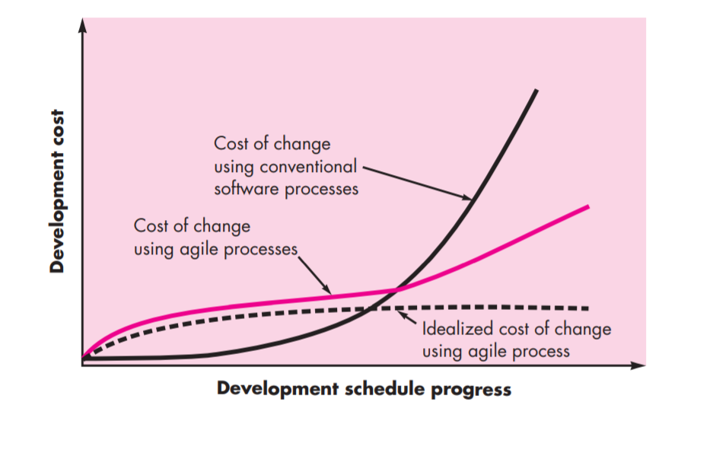
Software process model
Agile Process

Slide 35
Software process model
Scrum
It is one of the popular framework for the agile software development
If you go to scrum.org it defines its Better way Of Building Product.
Other popular frameworks are Kanban, Extreme Programming (XP)

Slide 36
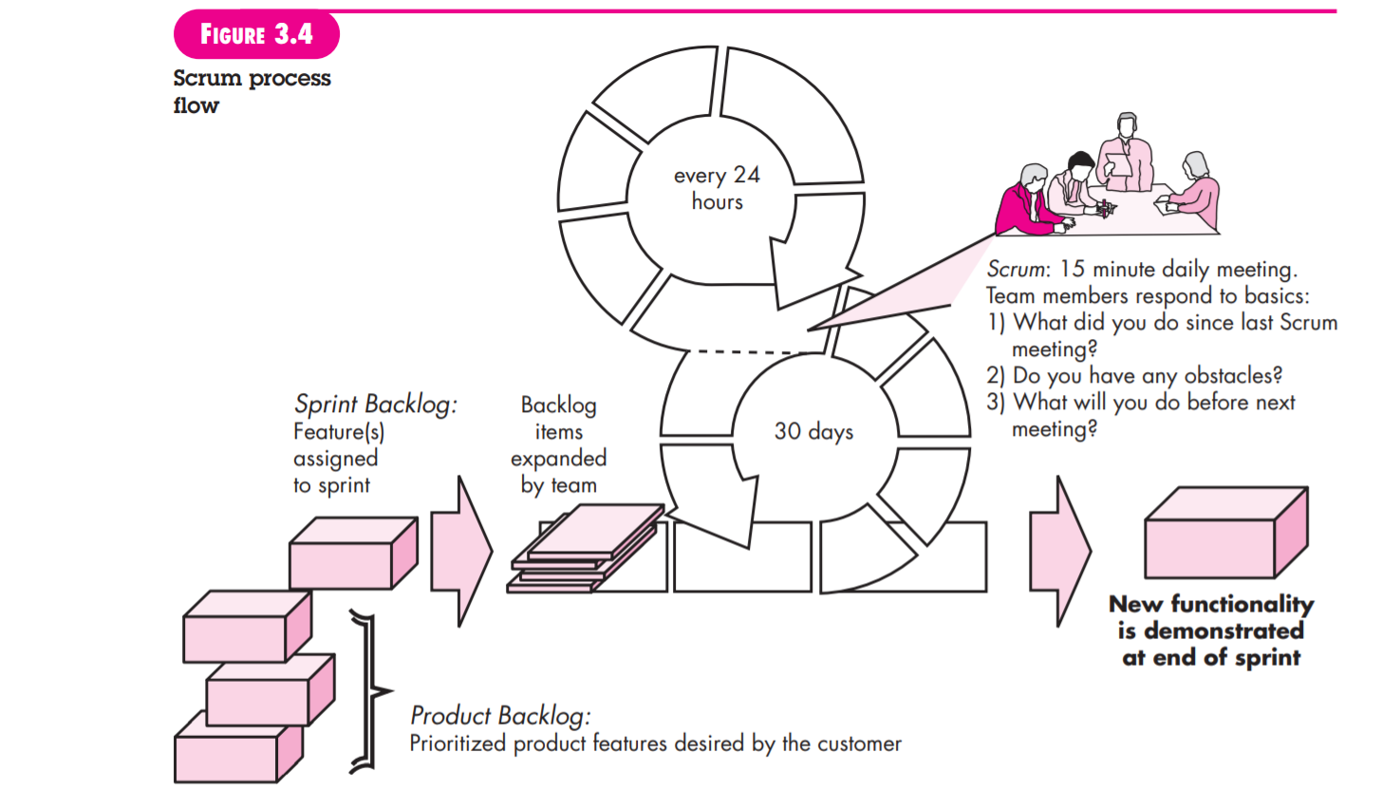
Software process model
Backlog

Slide 37
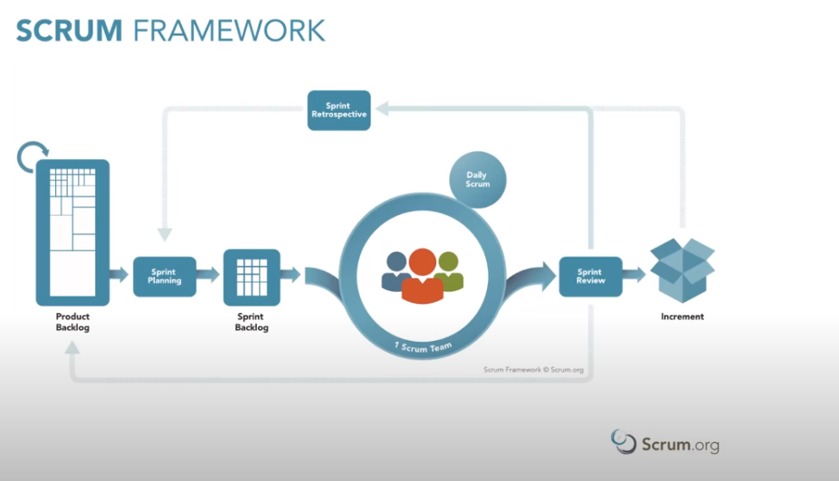
Software process model
Scrum process

Slide 38
Scrum
Backlog :
Items can be added to the backlog at any time (this is how changes are introduced).
The product owner assesses the backlog and updates priorities as required.
Sprint:
consist of work units that are required to achieve a requirement defined in the backlog that must be fit into a predefined time-box(typically 30 days).

Slide 39
Scrum
Scrum Meeting
Scrum meetings are short (typically 15 minutes) meetings held daily by the Scrum team.
Three key questions are asked and answered by all team members
• What did you do since the last team meeting?
• What obstacles are you encountering?
• What do you plan to accomplish by the next team meeting?

Slide 40
SCRUM
A team leader, Scrum master, leads the meeting and assesses the responses from each person.
The Scrum meeting helps the team to uncover potential problems as early as possible.
Demos:
Deliver the software increment to the customer so that functionality that has been implemented can be demonstrated and evaluated by the customer.
Demo may not contain all planned functionality, but rather those functions that can be delivered within the time-box that was established

